Slide 1
FACE DETECTION MODEL
SUBMITTED BY-
Yashasvi Tiwari [500082303]
Tanvi Saini [500083558]
Shubham Kaushik [500084144]
Shubham Arora [500082561]
Aahana Pandey [50008
Aditya Pilani [500083149]
Aarushi Arora [5000884089]

Slide 2
OBJECTIVE
To enforce the mandate for wearing masks in public places following the COVID-19 pandemic.
To effectively provides a working model for accurate mask detection.
To utilize image processing approaches to identify the presence of a mask on face.
To develop an efficient computer vision based system focused on the real time automated monitoring of people to detect face mask in public places.

Slide 3
Literature Survey
S.NO | Methodology | Description | Limitations
[1] | Study of Masked face detection approach in video analytics | The paper outlines, the principles used in each of these steps and the use of commonly available algorithms of people detection. This unique approach for the problem has created a method simpler in complexity thereby making real time implementation feasible. | The approach requires further analysis for the improvement in the performance of the technique.

Slide 4
S.NO | Methodology | Description | Limitations
[2] | A cascade framework for masked face detection | They propose a new CNN- based cascade framework which consists of three carefully designed convolutional neural networks to detect masked faces. Besides, because of the shortage of masked face training samples, a new dataset called “MASKED FACE dataset” to fortune our CNN models. The evaluation proposed masked face detection algorithm on the MASKED FACE testing set, and it achieves satisfactory performance. | The main limitation is that the authors have not utilized a real time morphing technique for the corresponding pixels.

Slide 5
S.NO | Methodology | Description | Limitations
[3] | Utilizing skin mask and face organs detection for improving the viola face detection method. | Approach to detect eyes and nose makes possible face detecting only with two eyes or one eye and nose, in addition to decrease false detection rate rather than viola approach. Implementing of this approach shows, the presented algorithm could reduce false negative from 10 percent to 2.4 and reduce false positive from 4.4 percent to 2.4. | There is an increased computational complexity that is observed in this research.

Slide 6
Problem Statement
The large scale losses that have been noticed across the world due to the covid-19 pandemic have been highly shocking and lead to a lot of loss of property and life. This virus is highly deadly and has caused multiple casualties which could be prevented through effectively preventive measures. Therefore use of mask enables effectively prevention and further spread of the virus which can be the main ingredient for stopping the infections in their path.
To ensure that the mask rule is been followed there needs to be an automatic technique that can provide highly accurate intelligent system for mask detection through image processing.
Wearing a mask in public settings is an effective way to keep the communities safe. As a response to the covid-19 pandemic, we open-sourced a face mask detection application created by Neural that uses AI to detect if people are wearing masks or not.

Slide 7
SCOPE
The system is easy to operate and it can be used in crowded areas. It also ensures the compliance for wearing mask and the system provides accurate assessment of the individual in public areas weather the person is wearing a mask or not.

Slide 8
System Architecture
Live feed
Frame capturing
Pre- processing
Region of Interest
Mask alert
Decision tree
Convolutional neural network

Slide 9
Module A: Frame Capturing
This is the initial step of the proposed model, here an open CV library is installed to enable the camera to capture the live video stream. Also, we use keras, numpy, scipy, tensorflow, imutils, matplotlib libraries to run the face mask detection model. Once the system is activated it start capturing the video frames, these frames are fed to the cascade classifier to detect the faces in that. This cascade classifier uses the HAAR features to identify the faces in the extracted frame as these features are stored in the cascade xml files. As the faces are identified, then the images set to pre-process by rescaling them with the width and height of 150 X 150 with the channel size of 3. then this image object is temporarily stored on the secondary drive to obtain the better features of the images for detection of mask.

Slide 10
Module B: Region of Interest
A region of interest (ROI) is a portion of an image that you want to filter or perform some other operation on. You define an RIO by creating a binary mask, which is a binary image that is the same size as the image you want to process with pixels that define the RIO set to 1 and all other pixel set to 0.

Slide 11
Skin Color Detection
TRAINING
Stochastic Back propagation.
Training patterns pre-whitened
Learning rate, decreased with each training epoch.
Train on equal number of skin and non-skin pixels.
NETWORK TOPOLOGY
Choose number of hidden units
Pixel color can be expressed in multiple colorspaces
RGB lab, XYZ and HSV
RGB provided fewest false positives.
RUNNING
All image pixels can be processed in under 1s.

Slide 12
Isolate Face Shapes
Resulting image from neural net had region of interests that were not true faces.
The unique oval- shape true faces were used.
To isolate most probable regions of interest, the test image is convolved with an oval mask.

Slide 13
Narrowing possible face
Increase speed of detection algorithm.
Test images showed that the faces were usually clustered.
We risk eliminating true faces, but we reject more false positives.

Slide 14

SOURCE CODE

Slide 15



Slide 16
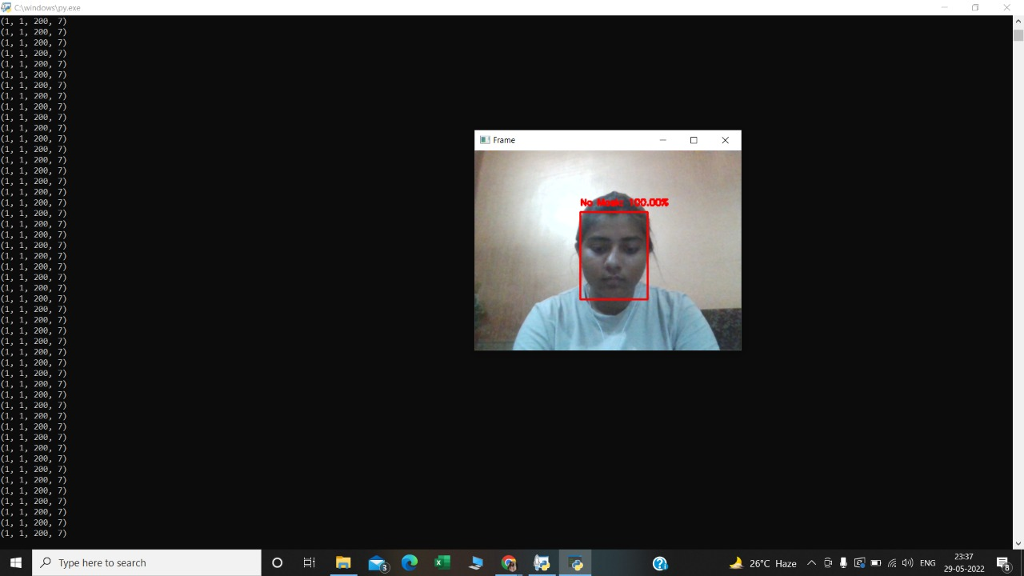
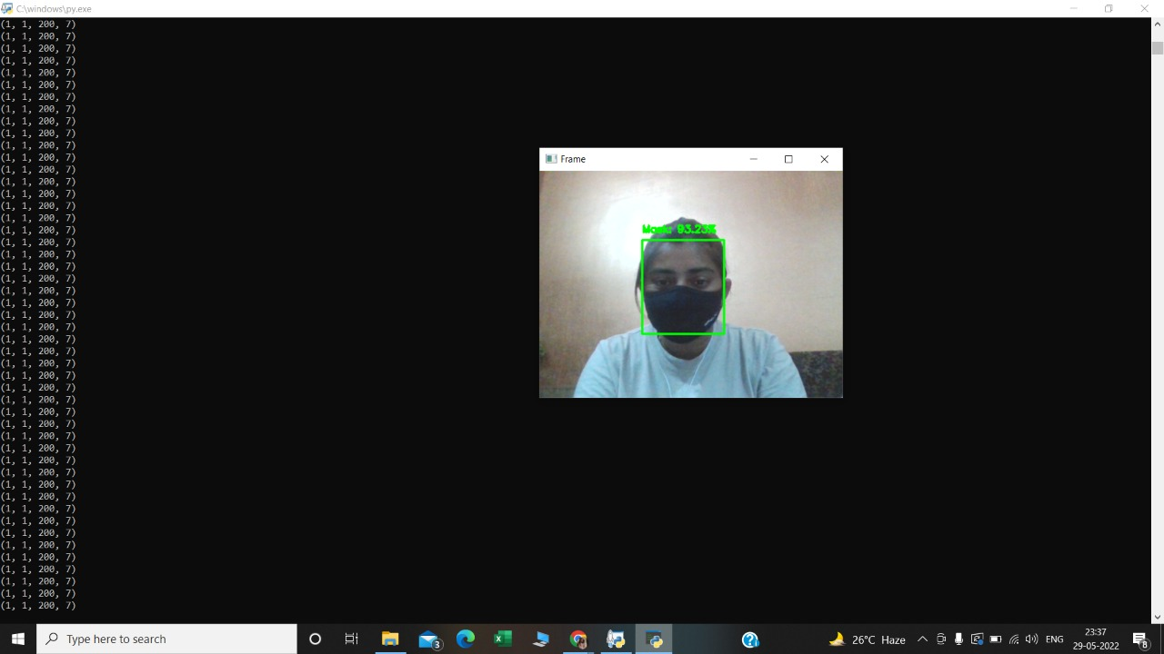
WORKING OF OUR MODEL

Slide 17
ADVANTAGES
Public places like Bus stand, Air ports and Railway stations.
Offices and education institutes.
BENEFITS
Cost effective
Curb covid-19 pandemic
Life saving

Slide 18
CONCLUSION
Efficient image capturing.
Efficient dataset training through CNN.
Successful face mask detection.
Maintaining alert status.

Slide 19
FUTURE SCOPE
Can be implemented as mobile applications.
Can be develop as API.

